Slide 1
Final Presentation
Track E Team 9
Babatunde Ayilola, Chao Fang, Jiaxin Liu, Fei Wu, Brian Murphy

Slide 2
What is the goal of the project?
Overarching Research Question: Do neighborhood features such as population health and social interaction patterns have an impact on COVID-19 outcomes in NYC?
Is there a correlation between general community health patterns and COVID-19 outcomes?
Is there a correlation between geographic mobility pattern and COVID-19 outcomes?
We would like to look into COVID-19 outcome from two perspectives:
Population Health
Social Interaction

Slide 3

Datasets Used and Limitations
NYC DOHMH Coronavirus (COVID-19) data
Pros:Has #Positives, #Deaths, and geography resources
Limits: Uses ModZCTA, and only in #tested
NYC Community Health Survey Data
Pros: Comprehensive data on resident’s health
Limits: Neighborhood data requires email, data requires cleaning, and geo-analysis ready data sets are old.

Slide 4
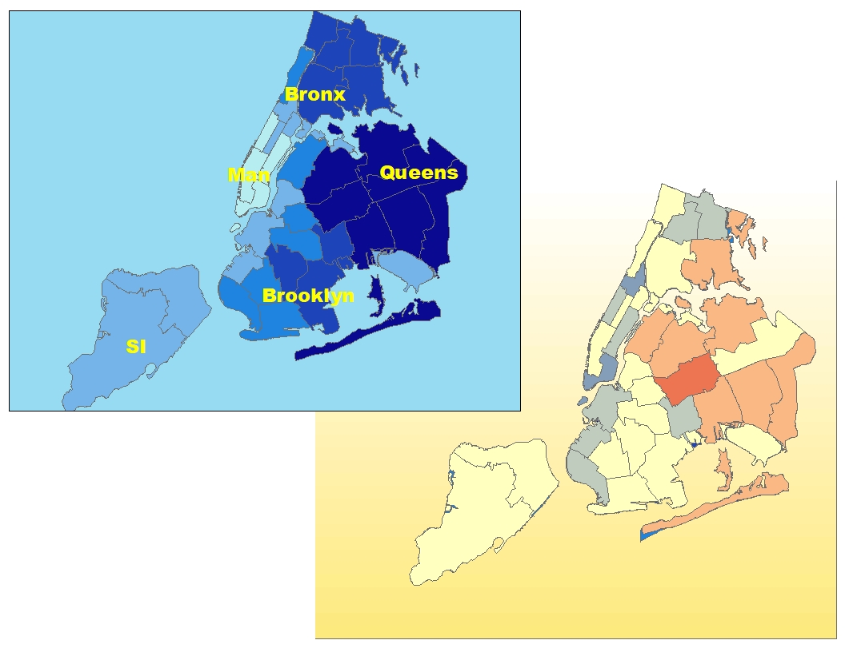
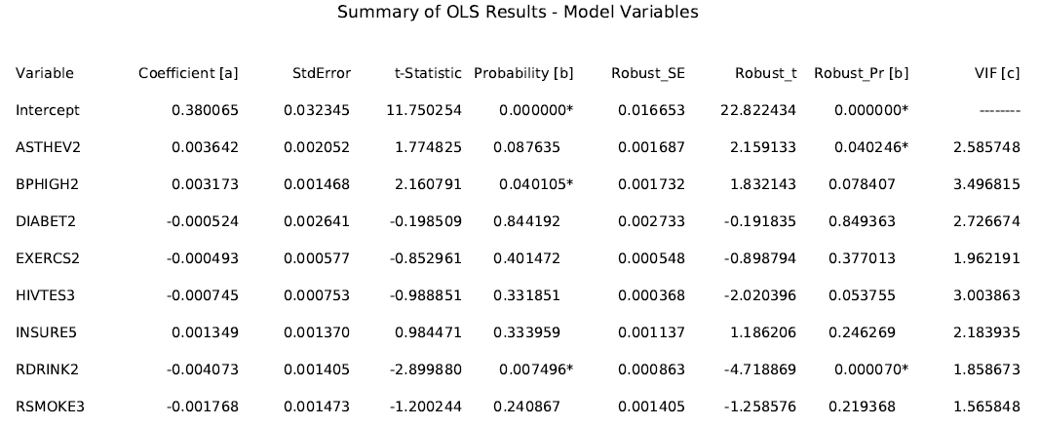
Community Health Patterns vs. COVID-19 Result

Slide 5

Datasets Used and Limitations
MTA Investor Information
Pros: Contains information on MTA ridership decline
Limits: Data in PDF, inconsistent reporting
MTA Turnstiles Data
Pros: Shows traffic by location at regular intervals
Limits: Requires cleaning before use
NYC DOHMH Coronavirus (COVID-19) data
Pros:Has #Positives, #Deaths, and geography resources
Limits: Uses ModZCTA

Slide 6
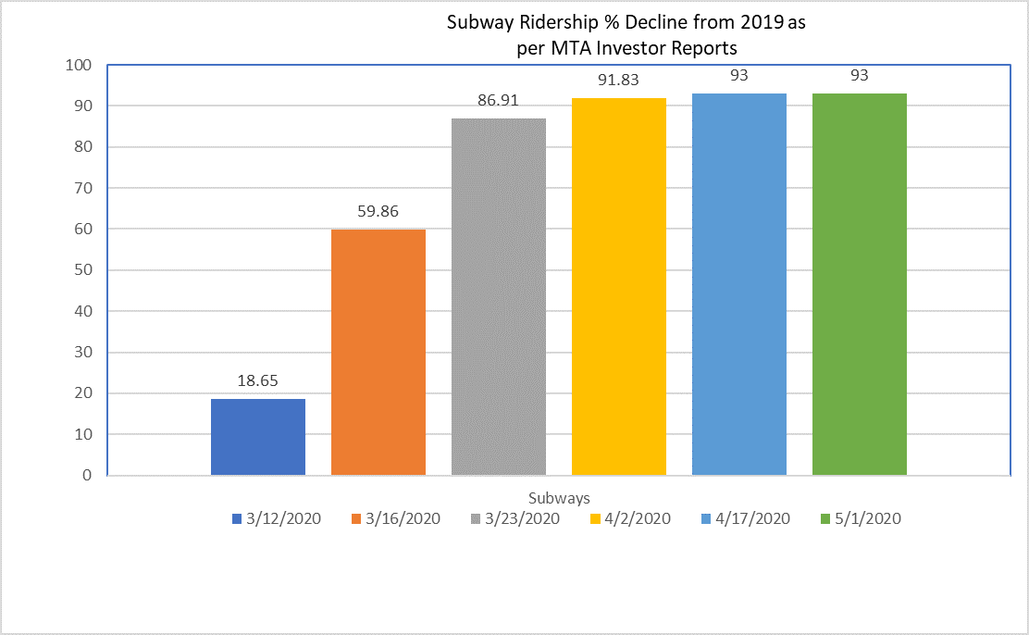
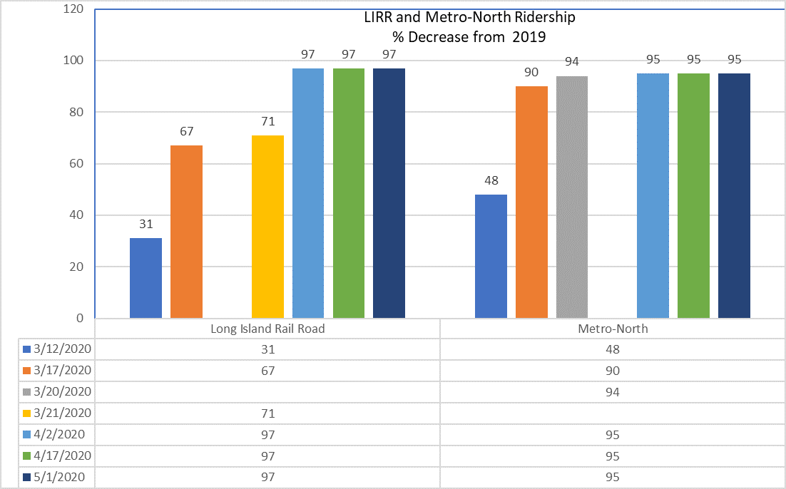
Covid Subway and Rail Ridership Impact
*From MTA Investor Information website
http://web.mta.info/mta/investor/index_new.html

Slide 7
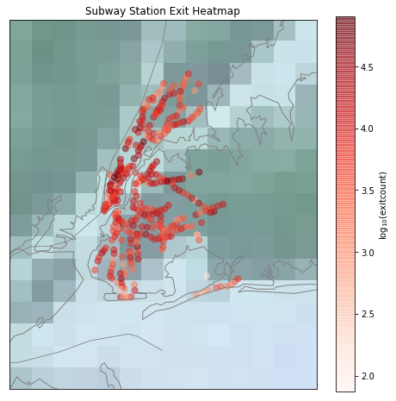
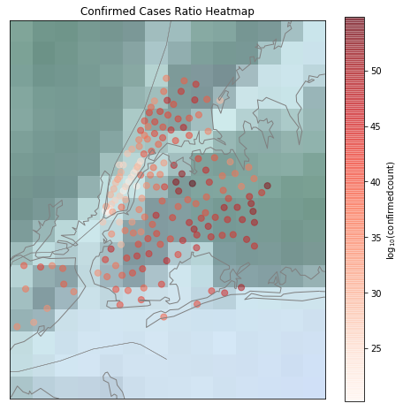
Subway Turnstile Entries vs. COVID-19 Visualization

Slide 8
Subway Turnstile Entries vs. COVID-19 Regression
Dependent Variable: | Positive cases in Zip code area
 | (1) | (2) | (3)
 | Pooled OLS | SEM w/ FE | SEM w/ RE
#turnstile in Zip | -0.0002 | -0.002*** | -0.0003
#totalcase in NYC | 0.003*** | 0.001*** | 0.001***
#turnstile * #totalcase | -9x10^-8 | 2.31x10^-8 | 6x10^-8**
Intercept | -11.642*** | 1.296 | -6.78**
Lambda |  | 0.76*** | 0.76***
N | 4,104 | 4,104 | 4,104
R-sq | 0.1318 | 0.0576 | 0.1279
* p<0.10, ** p<0.05, *** p<0.01
Notes:
The dependent variable is the number of positive cases in each zip code area at time t. The independent variables #turnstile in Zip and #totalcase in NYC are the number turnstile entries in each zip code area and number of confirmed cases in the New York city at time t-5. They were collected 5 days before the outcome variable. I use five days because the median of incubation period is 5 days.
From the Spatial Error Models (SEMs), the coefficients on number of turnstiles in each zip code area are negative, and it is significant at 1% level in SEM w/ Fixed Effect. It shows that the increase in number of turnstiles is associated with decreases of daily increased positive cases in each zip code area if there aren’t any newly confirmed cases in New York City, because there is a interaction term #turnstile * #totalcase. What’s more, the positive and significant coefficient on #turnstile * #totalcase in the third model shows that the the more turnstile entries is associated with more positive cases in each zip code area if there are any confirmed cases in NYC. The effect of turnstile entries will increase as total cases in NYC increases.

Slide 9
General Timeline
Moday
Tuesday
Wednesday
Friday
Saturday
First Team Meeting
Direction Proposal
Midpoint Presentation
Final Check-in
Final Presentation
- Self-Introductions
- Propose potential directions
- Prepare overall structure on each direction
- Sync-up with mentor on plans/overall structure for each direction
- Present proposal
- Data cleaning complete
- Data analysis complete
- Summarize project result
- Final presentation
- Project complete!

